Slide 1
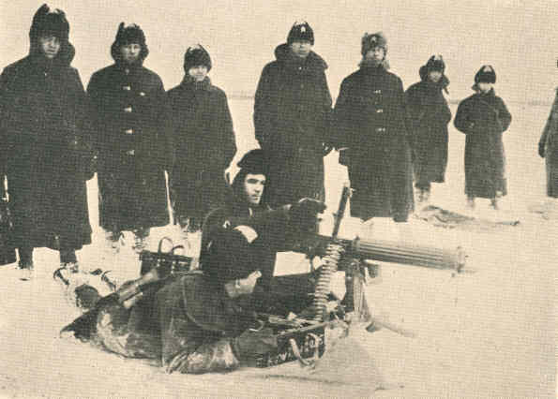
The Tsar and The first World War

Slide 2
The Road to War
Russia established itself as the protector of the Slavic people
Archduke Franz Ferdinand was assassinated and Austria declares war on Serbia
“Virtually impossible for Russia to avoid being drawn into a European war”
- Lynch

Slide 3
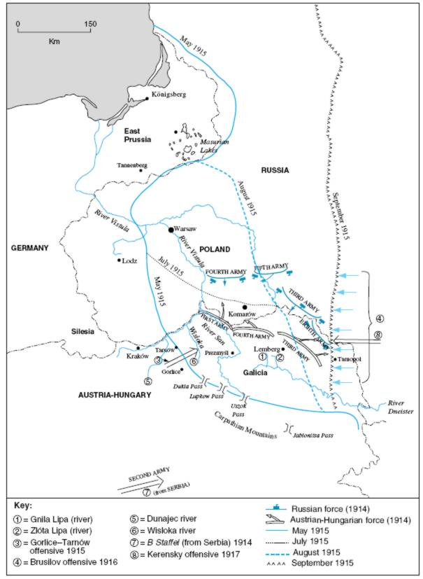
The Road to War
Russia mobilises its troops along Austria’s border
Germany declares war on Russia on 1st August 1914

Slide 4
The Road to War
The people of the nation initially rallied to the Tsar
Discontent with the lack of reform by the Duma was forgotten for a little while...
BUT: revolutionaries still pushed the idea that it was a bourgeois war

Slide 5
The Road to War
Lynch
Bolsheviks seen as traitors for opposing the war
“Had the war gone well...the Bolsheviks would have been hard pressed to survive”

Slide 6
The Military Situation
Russian army was advanced on by the Germans – heavily beaten
Russian weaknesses were exposed during the fighting

Slide 7
The Military Situation

Slide 8
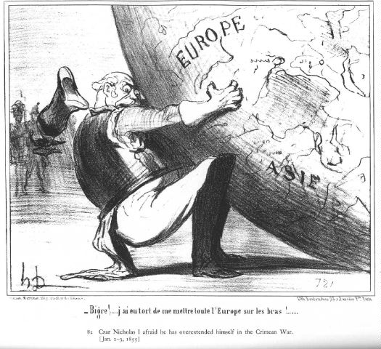
The Military Situation
The government was unprepared / incapable of organising the country to face the strains of war

Slide 9
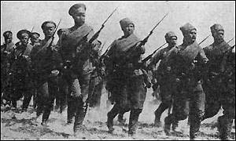
The Military Situation
Lack of equipment
Dec 1914 – 4.7 million rifles for 6.5 million men
Shortage of boots – troops fought barefoot
Both led to mass surrenders of Russian regiments to the Germans

Slide 10
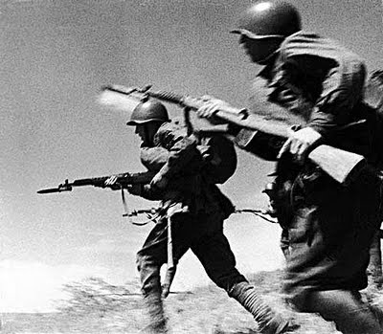
The Military Situation
Low morale of soldiers and citizens
Military report in Christian:
“The officers not infrequently even refused to lead their units against the enemy because they are afraid of being killed by their own men”
In an attempt to boost the military morale and regain the people’s confidence...

Slide 11
The Military Situation
Tsar Nicholas II took over military command of the Russian forces
“Once war had been declared, the Tsar had been wholly committed to it” - Lynch
Unfortunately, he then became responsible for the war

Slide 12
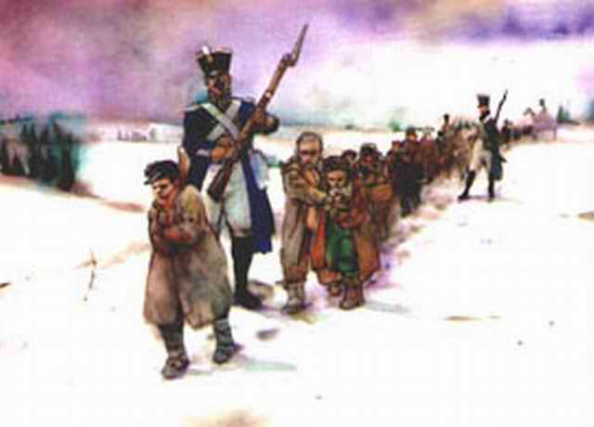
The Military Situation
Eventually, the war itself led to the mass dissent that caused the 1917 Revolution
By 1917
1.7 million dead
8 million wounded
2.5 million taken prisoner (Christian)

Slide 13
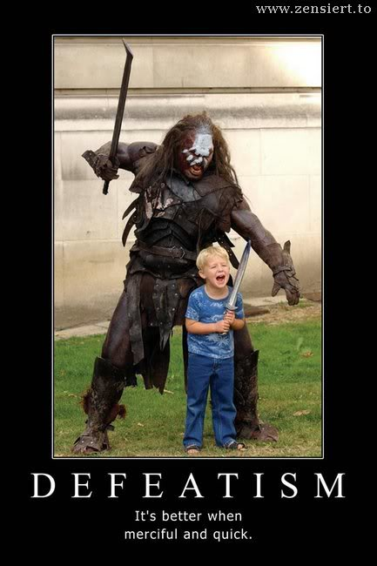
The Military Situation
“The enthusiasm and high morale of August 1914 had turned into pessimism and defeatism”
“The war would prove to be the undoing of Tsardom”
- Lynch

Slide 14
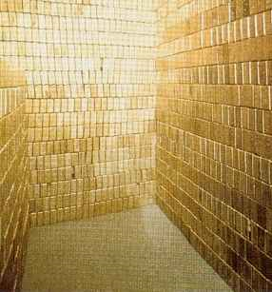
The Economic Situation
Russia was in a good position in the beginning of the war
Had the most gold reserves out of any nation
But the war caused many problems for the Russian economy
Between 1914-1917, the war cost Russia over 1.5 billion roubles

Slide 15
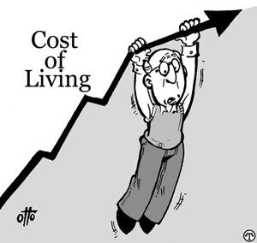
The Economic Situation
Led to an increase in wages...
BUT: cost of living increased to a greater extreme

Slide 16
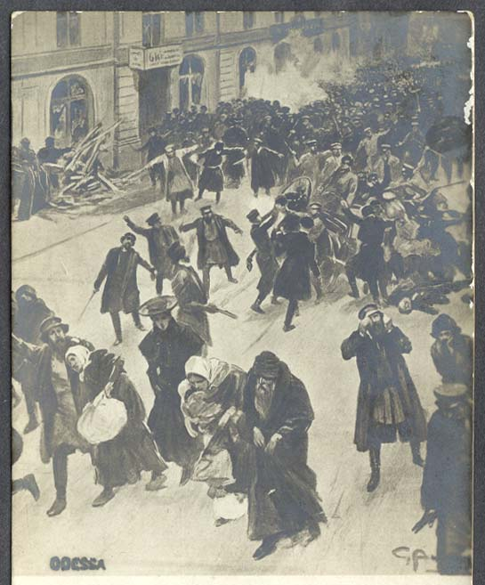
The Economic Situation
Lynch
“Three years of total war were to prove too great a strain for the Russian economy to bear”
“The demands of the war proved too heavy for Russia to sustain”
Vernadsky G, & R.T. Fisher, A Source Book for Russian History

Slide 17
The Economic Situation
Russia, to pay for the war, increased taxation and printed more money
Increased taxation hurt the peasants and workers hard
Printing more money merely led to inflation
Vernadsky G, & R.T. Fisher, A Source Book for Russian History

Slide 18
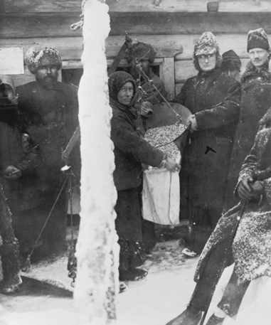
The Economic Situation
Wages rose 50% in most, 100 - 200% in certain areas
Price of products (food, clothing etc.) rose 100 - 500%

Slide 19
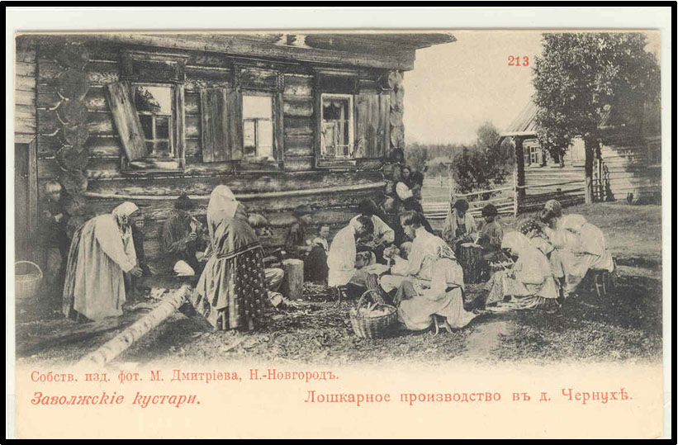
The Economic Situation
War led to a lack of coal and wood in the cities
Led to unsanitary living conditions
Cold and dampness

Slide 20
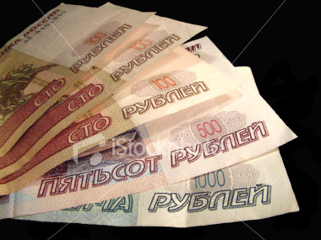
The Economic Situation
Inflation
The war swallowed up over 1.5 billion roubles
Russia abandoned the gold standard – printed more money
But led to inflation – money become increasingly worthless

Slide 21
The Economic Situation
Food Supplies
Inflation made trading unprofitable
Peasants began hoarding their products
Army confiscated horses from farmers

Slide 22
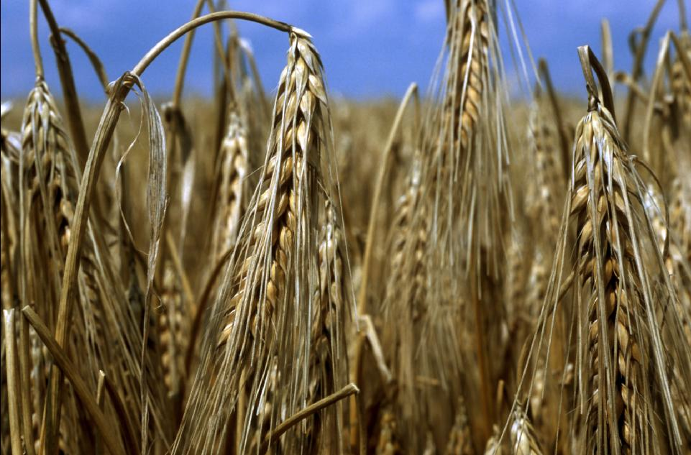
The Economic Situation
Food Supplies
1914 – 25% of the grain harvest was put on the market
1917 – only 15%

Slide 23
The Economic Situation
Food Supplies
Govt banned the production and sale of alcohol
...unfortunately accounted for almost 1/3 of the governments revenue
(Christian)

Slide 24
The Economic Situation
Food Supplies
Army had priority on roads and railway
Hampered the distribution of grain
Petrograd suffered being isolated from grain producing regions
Daily civilian bread rations | (In Pounds)
Jan 1916 | 2.7
Dec 1916 | 2.3
March 1917 | 1.8

Slide 25
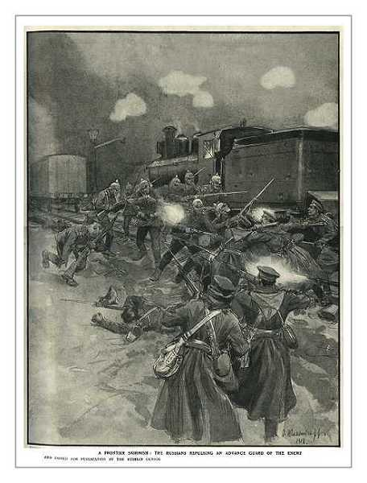
The Economic Situation
Transport
Disruption of the transport system affected the nation more than food shortages
Could not meet the demands of war
Blocked lines and breakdowns became common

Slide 26
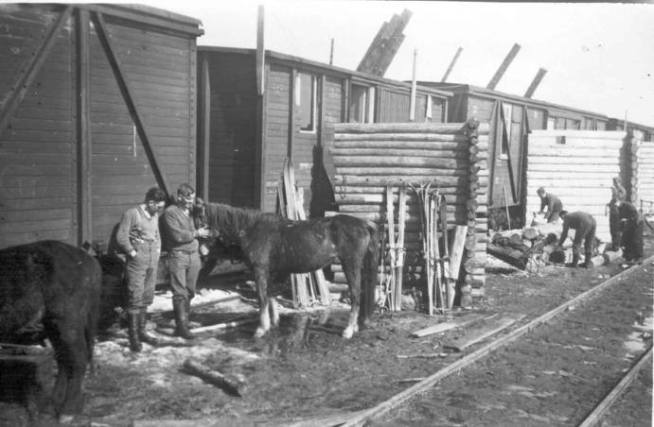
The Economic Situation
Transport
“2 years after the war began, the Russian railway system had virtually collapsed”
Food rotted in railway trucks that could not be moved

Slide 27
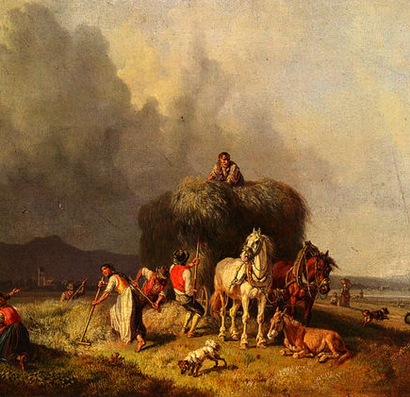
The Economic Situation
Transport
Moscow – no. of wagons of food delivered:
Before the war 1917
2,200 per month 700 per month

Slide 28
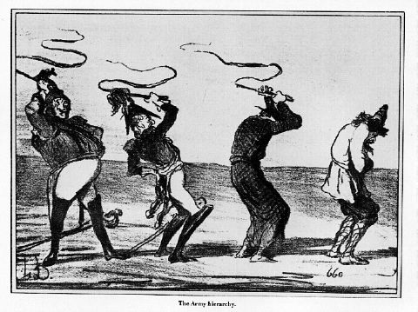
The Political Situation
Tsar was an inept military and political leader
Revolution of 1917 was initiated by the very people who SUPPORTED the Tsar in 1914
They became fed-up with his incompetence

Slide 29
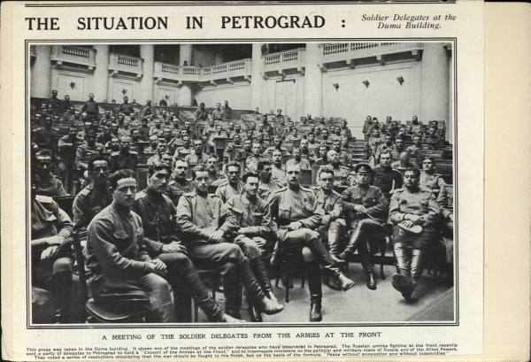
The Political Situation
Duma originally showed its support by suspending itself in 1914
However, by August 1915, Nicholas II bowed to pressure and allowed the Duma to re-assemble

Slide 30
The Political Situation
Union of Zemstvas (called the Zemgor) – banded together to assist the Tsar
He officially refused their assistance

Slide 31
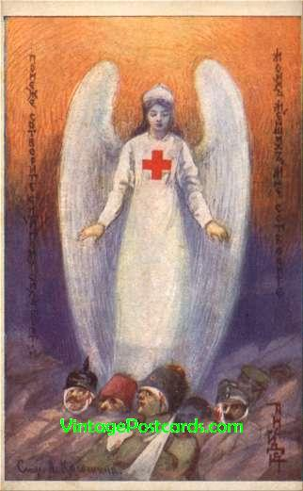
The Political Situation
This group devoted itself to helping the Russian wounded
Success of this group showed that there were workable alternatives to Tsarism

Slide 32
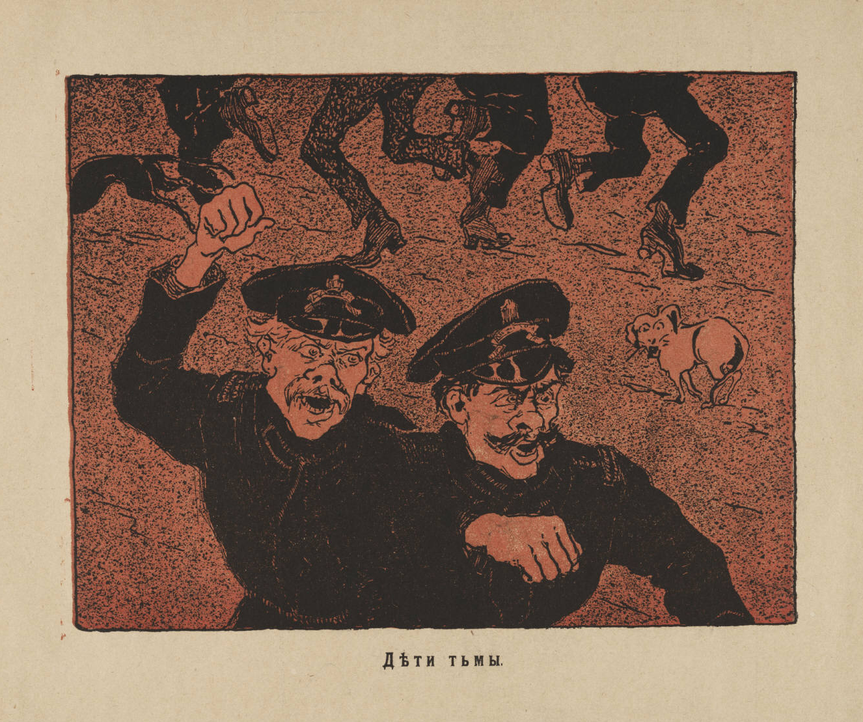
The Political Situation
Lynch
The Tsar “brushed aside the hand
that was offered [to] them”

Slide 33
The Political Situation
The Duma, denied their voice, formed into a ‘Progressive Bloc’
236 of 422 deputies
Tried to advise the Tsar – unheeded
Bloc became the focal point of resistance

Slide 34
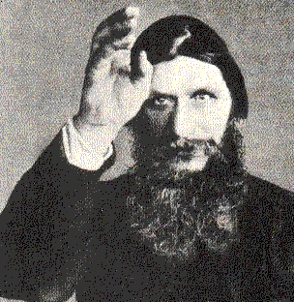
The Political Situation
Tsar was away fighting the war
Tsarina’s influence on politics caused issues at the home front
Rumours of a conspiracy with the Germans (she had German descent)
She was influenced by the infamous Grigori Effimovich Rasputin

Slide 35
Rasputin
Mystic from Siberia
Reputed to have the powers of healing and prophecy
Tsarina believed he was sent by God to save her son Alexi (who was haemophilic)

Slide 36
Rasputin
Nicholas also accepted Rasputin
Believed through Rasputin he (Nicholas) could keep in touch with the ordinary peasant
Rasputin had peasant origins

Slide 37
Rasputin
Rasputin had little schooling in either education or politics
Made loyal monarchists and nobles uneasy, Lynch:
“Even the strongest supporters of Tsardom found it difficult to defend a system under the sway of a debauched monk”

Slide 38
The Death of Rasputin
Felix Youssoupoff planned to kill Rasputin
Fed him cakes and wine laced with cyanide (which Rasputin consumed a large quantity of)
When he was disposing of the body he realised Rasputin was still alive

Slide 39
The Death of Rasputin
Rasputin attacked Youssoupoff , the Youssoupoff shot him 4 times in the heart and threw him in the river
People reported Rasputin to still be alive when he was drowned...

Slide 40
Results
Death of Rasputin (1916) did little to stop the dissent in Russia
There were still economic issues rife throughout the nation due to the war effort

Slide 41
Results
Fuel shortages
One of the coldest winters on record
Accelerated cost of living

Slide 42
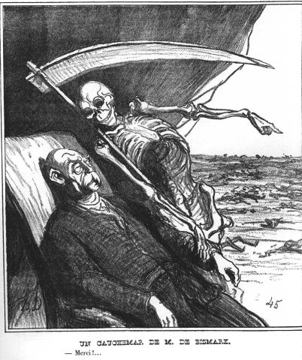
Results
Disillusionment with Tsarism gathered momentum
There was widespread unrest among the industrial proletariat of Petrograd and Moscow

Slide 43
Results
There were 3 major leading groups that represented the opposition to the Tsar in this period
Central War Industries Committee
All-Russian Union of Towns
All-Russian Union of Zemstva

Slide 44
Results
The Progressive Bloc in the Duma was then formed
First real chance at a unified government

Slide 45
Results
BUT:
The Tsar suspended the Duma in August 1915
By this act, the Tsar had alienated support across the entire political spectrum

Slide 46
Results
By 1917, the Tsar had lost nearly all of his support
The Home Front was in constant uproar
The time was ripe for revolution

Slide 47
A few summary notes not in your handout

Slide 48
Conclusion
Tsar took control of the army
Had NO SKILL or STRATEGY
Millions died
Anger was placed on the Tsar

Slide 49
Conclusion
Conscripted peasants left their farms
Caused a severe shortages of food and materials
Inadequate supplies for the front
Food shortages in the towns
Coal shortages leading to power failures
Conscripted Russians felt angry at the Tsar for being dragged into a war

Slide 50
Conclusion
Tsar was seen as inept and unable to rule due to the many Russian defeats
Generals in his own army and the Duma asked for his abdication
After taking command of the army, leaves his incompetent wife in charge, who looked for assistance through Rasputin

Slide 51
Historiography
Liberal View - Pipes
“…while the collapse of tsarism was not inevitable, it was made likely by deep-seated cultural and political flaws that prevented the tsarist regime from adjusting to the economic and cultural growth of the country, flaws that proved fatal under the pressure generated by World War I”.

Slide 52
Historiography
Revisionist View - Wood
“The tsar foolishly added to his own isolation by assuming personal command of the Russian army in 1915. His unhelpful presence at military headquarters in Mogilev left the conduct of affairs in the capital…in the hands of his neurotic wife – contemptuously known by the public as nemka (‘the German Woman’) – and the abominable Rasputin.”

Slide 53
Historiography
Revisionist View - Figes
“…whereas the other European powers managed to adapt and improvise, the tsarist system proved much too rigid and unwieldy, too inflexible and set in its ways, too authoritarian and inefficient, to adapt itself to the situation as it changed. The First World War was a titanic test for the states of Europe – and one that Tsarism failed in a singular and catastrophic way.”

Slide 54
Historiography
Western-Marxist View - Hill
“The fundamental cause of the Russian Revolution, then, was the incompatibility of the tsarist state with the demands of modern civilization. War accelerated the development of revolutionary crises, but their deep-lying causes could not be wished away in times of peace.”

Slide 55
Historiography
Soviet View - History of the CPSU (b.) short course
The war, while it was a reflection of the general crisis of capitalism, at the same time aggravated this crisis and weakened world capitalism. The workers of Russia and the Bolshevik Party were the first in the world successfully to take advantage of the weakness of capitalism. They forced a breach in the imperialist front, overthrew the tsar and set up Soviets of Workers' and Soldiers' Deputies

Slide 56
Summary Diagrams
Russia goes to War
Reasons
Defence of Serbia
Access to Mediterranean
Had to mobilise
Immediate Effects
Surge of popularity for the Tsar
Intense Nationalism
Shattering of anti-war parties

Slide 57
Summary Diagrams
LONG TERM EFFECTS
Military
Incompetent High Command
Lack of Resources
Appalling casualty figures
Economic
High Inflation
Acute food shortages
Inadequate transport system
Political
Lack of leadership from an incapable Tsar
Failure of ruling elite to cope with the demands of war
Growth of opposition in the Duma
Hatred for Tsarina and Rasputin

Slide 58
Summary Diagrams
The February Revolution
Unrest on the streets
Duma refuses to disband
Increased desertion of troops at the Front
Army officers advise the Tsar to stand down
Formation of Petrograd Soviet
----------------
Nicholas II abdicates -> end of Romanov dynasty
Provisional government established

