Slide 1
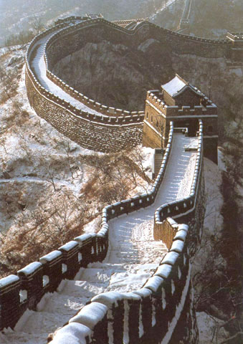
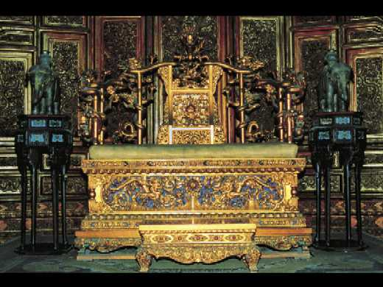
Chinese Revolution
People, Language, Land, Dynasties and the role of Emperor

Slide 2
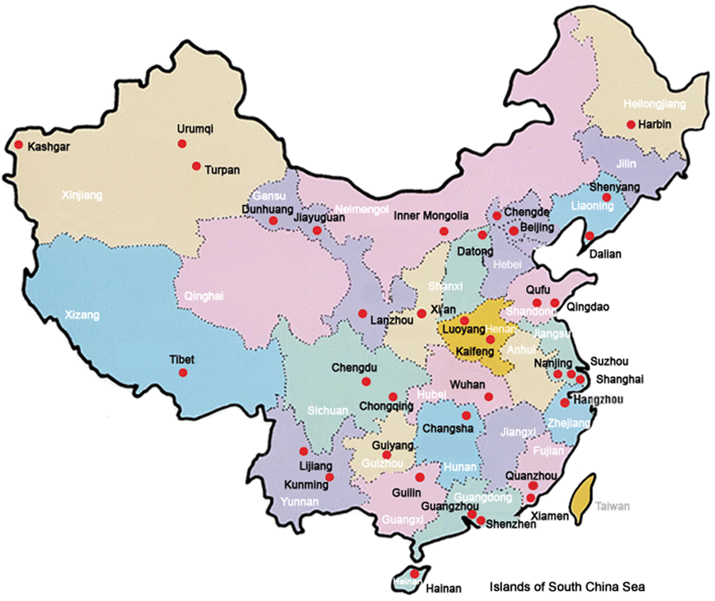
Land
China covers 9.6 million square kilometres and is the third largest country in the world. It is the biggest country Asia. Its population by 1900 was estimated to be around 489 million.

Slide 3
Languages
The main languages in China were;
West- Tibetan and Uighur
North- Kazakh, Mongol and Manchu
South- Burmese
South East- Wu, Min, Gan, Xiang, Thai, Keija
Over the whole of China, Mandarin was the most common language used.

Slide 4
The role of the Emperor
The Emperor was revered as the ‘Son of Heaven’.
He commanded complete obedience from all his servants and the people of China.
Normal people of China would never meet nor lay eyes on the Emperor.
People were to look away when ever the Emperor was traveling past
To speak out or question the Emperor’s decisions was unthinkable.
He would say in the Forbidden city in Beijing.
Would compose new laws, carry out rituals and bring prosperity to the land.
One ritual was to ensure good harvests across the land. Made at the Temple of Heaven in Beijing.
If natural disasters were to occur, it was seen as a sign that the gods were unhappy with the rule of the emperor over the land.

Slide 5
Dynasties
Qin Dynasty 221-207 BCE
Was the first dynasty to unite the people of China
Emperor was Qin Shi Huang
Ruled China in an Authoritarian manner with a centralised government
Qin was responsible for the start of construction of the Great Wall.
Intended to keep the ‘barbarians’ out from the north.
Buried with the army of terracotta warriors.
His empire fell into civil war after his death
Han Dynasty 202 BCE- 220 CE
Said to be the greatest periods in Chinese History.
Emperor was Liu Bang
Kept much of the Qin ruling system but was less Authoritarian
Trade through the Silk Road was established.
Any country wanting to trade goods with China was to pay their respects to the Emperor
The Han dynasty fell due to corruption and political rivalry

Slide 6
Tang Dynasty 618-907
Is also considered one of China’s golden periods
Stability and progress led to an increased population
Had a powerful military and led to an expansion of the empire
Was interrupted for 80 years because of the Zhou dynasty but was overthrown in a military coup.
The dynasty collapsed following a period of natural disasters and regional rebellions
Song Dynasty 960-1279
Was the first government to introduce paper money in the world
Military technology such as gunpowder was invented
Ming Dynasty 1368-1644
Was the last ethnically Han dynasty to rule China
The Forbidden city in Beijing was built and the Great Wall restored
Social stability and an orderly government
Economic difficulties and natural disasters ended the dynasty

Slide 7
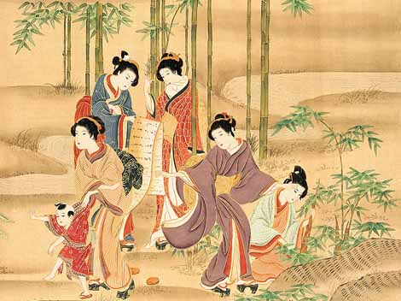
Qing Dynasty 1644-1911
Qing was the last imperial dynasty
The dynasty adopted many of the Chinese civil and cultural structures as well as introducing their own.
Han Chinese men were forced to wear Manchu-style dress. Or risk being killed.
Also queue haircut (shaved at the front of the head and the rest into a plait)
Women weren't forced to bind their feet, however many Chinese women still choose to continue the practice.
Emperor Kangxi was the longest individual rule over China
Under the reign of Qianlong, imperial China experienced its greatest period of administrative stability, prosperity and cultural advisement. This led to an increase in population and extension of the empire.

