Slide 1
Internal Conflicts

Slide 2
Nien Rebellion
The Nien Rebellion ravaged the Henan-Hubei-Shaanxi region between 1850 and 1868.
Poverty led many families to kill their female children to conserve food.
As a result a generation of males grew to young adulthood with no prospect of marriage or prosperity.
Even though these men had no distinct political vision or religious identity, under the leadership of Zhang Luoxing, the Nien grew to a force of 40,000 men by 1851.

Slide 3
Muslim Rebellions
The Muslim Rebellion was set off after a dispute between local Muslims and visiting Chinese merchants over the price of bamboo poles.
During the 1860’s heavy taxation and cultural tensions led to rebellion in provinces of Shaanxi and Gansu.
Muslim rebellions in the southern provinces of Yunnan soon followed in the 1870’s.
Zuo Zongtang was given the job of ending the Muslim uprisings and successfully combined military might with economic rehabilitation of areas affected by rebellion to bring regions under control.

Slide 4
Taiping Rebellion
Was founded by Hong Xiuquan who belonged to the minority Hakka people who spoke their own dialect and had different cultural customs to Han Chinese.
He worked hard to gain a good education, earning a living as a schoolteacher. However he repeatedly failed his Imperial examinations.
After his third failing in 1837, he became quite ill and experienced feverish delusions during which he would constantly call out ‘Slay the Demons, Slay the Demons’
Once Hong recovered he claimed that he had great visions where he was visited by Jesus Christ. He began to say that he was the son of God and elder brother of Jesus.

Slide 5
Taiping Rebellion
Hong founded a religious group the Association of God Worshippers, attracting a large number of followers particularly amongst poor workers and farmers.
Hong had over 30,000 followers by 1850.
The God Worshippers preached equality between men and women, communal ownership and cultivation and equal distribution of food and clothing. Condemning concubinage, prostitution, foot-binding, opium smoking and arranged marriage.

Slide 6
Taiping Rebellion
In July 1850 conflict between Qing authorities and the God Worshippers broke out.
Hong announced the formation of a new political order known as the Heavenly Kingdom of Great Peace. With Hong naming himself the Heavenly King.
The Taiping achieved considerable military victories. Their commanders were skilled, soldiers were dedicated, their ideology encouraged discipline, land reforms social welfare initiatives attracted poor and landless.
The Taiping rebellion affected sixteen of China’s 18 provinces, capturing 600 cities
1853 Taiping forces seized Najing making it their capital and for ten years there two governments and two capitals in china. The Qing in Beijing and the Taiping in Nanjing.

Slide 7
Taiping Rebellion
After the second Opium War western military advisors were made available to the Qing.
The Ever Victorious Army was formed with Chinese and Western soldiers and were commanded by Charles ‘Chinese’ Gordon. They fought along side the Qing.
Zeng Guofan was the commander in chief of Qing forces opposing the Taiping.
Zeng’s troops were deeply dedicated to Zeng and under his leadership, with the aid of Western artillery the Qing began to turn back the rebels.
Meanwhile Factionalism and internal division was undermining unity in Taiping forces.

Slide 8
Taiping Rebellion
Despite the Taiping capturing much territory they had not built up effective military control over all their lands.
Najing was retaken and the Heavenly King, Hong Xiquan committed suicide.
The 14 year Taiping Rebellion was over but the damage was already done and the Qing regained power.
The Taiping Rebellion was the most destructive civil war of modern times with approximately 30-40 million people killed.
Some regions ended up worse off as causes of the rebellion remained unaddressed.
The Taiping Rebellion became a revolutionary example that would later inspire radical leaders.

Slide 9
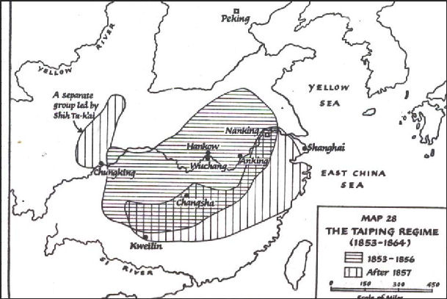
Areas under Taiping control

