Slide 1
Religion, society and Government

Slide 2
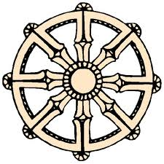
Religion

Slide 3
Confucianism
Based on the ideals of the philosopher Confucius (551-479BCE).
Seen more as a philosophy than a religion
Emphasises the need for respectful relationships in order to maintain social harmony.
It states that a Nobel person should aspire to 5 virtues:
Benevolence
Wisdom
Trustworthiness
Righteousness
Proper conduct

Slide 4
Confucianism continued…
The 5 virtues led to the 5 relationships:
Son to father
Wife to husband
Younger brother to elder brother
Friend to friend
People to ruler
It enforced the rigid hierarchy of China’s social structure and created a society that was built on obedience
It supported the idea that if all relationships within society are equal then harmony will prevail.
Natural disasters were seen as signs that the emperor had failed to maintain a virtuous relationship with society and therefore his ability to rule was in jeopardy

Slide 5
Daoism
It was founded by Laozi who stated that it was important to be in harmony with the way of nature.
The natural order of things should not be disturbed which in a political sense
meant that a leader should
govern with as little interference
in day to day life as possible.

Slide 6
Daoism continued…
Daoism further strengthened the existence of the social hierarchy that existed in China.
While Daoism appeared to contradict the values of Confucianism, the people of China took wisdom from both philosophies.

Slide 7
Buddhism
People were drawn to Buddhism because of the rewards that were offered for redemption and the emphasis that was placed on charity, kindness and preservation of life.
Buddhism came to China towards the end of the Han Dynasty which was
causing social upheaval.
During this time of instability, the
people of China turned to ‘The
four noble truths’

Slide 8
Buddhism continued…
The four noble truths were as follows:
Life entails suffering
Suffering is due to attachment, which causes anxiety and disappointment
Suffering can be overcome if attachment is given up
Leading a virtuous, disciplined life and practicing mediation can conquer attachment. Insight will overcome ignorance, thereby revealing the path to enlightenment.

Slide 9
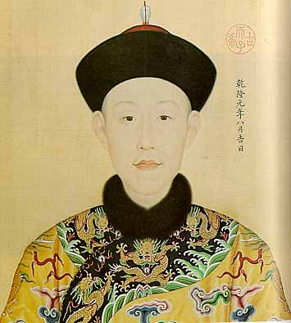
Government

Slide 10
Government
Government was made up of elite intellectuals who made their way into these superior positions through a series of strict examinations.
In contrast to the gentry, those who were part of the Shenshi did not inherit the privileged status from their ancestors.

Slide 11
Government continued…
The examinations were based on their Confucian education and involved testing knowledge in the following areas:
Literature
History
Philosophy
Confucian theory
Practical subjects such as economics were not considered important.

Slide 12
Government continued…
The examinations were set up as a series of level with increasing degrees of difficulty.
Some Shenshi took the opportunity to set the higher exams and work in the Imperial Government while others were happy to work in local administrative roles.
They wore special robes and grew their finger nails long to show that they did not do any manual labour.

Slide 13
Government continued…
Those who earned a higher degree and had the ability to serve the Government were known as Mandarin.
The Mandarin had the ability to dominate and control political life and for this reason they were determined to prevent reform.
They supported the religious ideals that discouraged change and for this reason the people of China were suppressed.

Slide 14
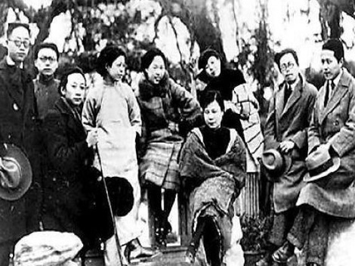
Society

Slide 15
Social Hierarchy
Throughout China there was a very strict and rigid social order or hierarchy.
Those who were at the top ensured that they maintained their position
Peasants were higher up because they produced the grain. Without it people would starve.
Soldiers were lower down because they killed people for a living.
The social order was as follows:

Slide 16
Social Hierarchy continued…
Emperor
Royal Family
Mandarin
Shenshi
Peasants
Labourers
Artisans
Merchants
Soldiers
Actors, gravediggers and prostitutes

Slide 17
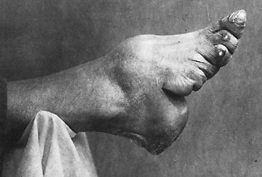
Foot binding practices
Foot binding was a common practice for Chinese women.
It involved tightly binding the feet of young girls from the age of five in order to stunt the growth and create what were called ‘Golden Lily feet.’
Foot binding brought the heels and toes so close together that it would eventually cause deformation and the women would have difficulty walking due to constant
and severe discomfort

Slide 18
Foot binding continued…
Foot binding was seen as attractive and pretty to look at.
It was something that was done by all classes of the Han in addition to some other Chinese, however it was not something that was done by the Manchu or Mongols.
The only families that did not do foot binding were those who were very poor and needed the girls to work in the fields, or those who did not have time to bind the feet.

Slide 19
Role of religion
The religions that were practiced by the Chinese involved philosophies which promoted respectful relationships to maintain social harmony and not disturbing the natural order of things.
For this reason the people at the lower end of the social hierarchy found it difficult to improve their situation due to reluctance of the upper classes to allow reforms.

Slide 20
Role of religion continued…
As a result the Chinese society was particularly regimented.
This meant that society was organised in a very strict pattern which resulted in the oppression of the lower classes.

Slide 21
The role of Manchu traditions
The Manchu people formed the Qing Dynasty which ruled from 1644-1911.
While they adopted many Chinese traditions they also had very strict customs of their own which they imposed on the rest of society.

Slide 22
Role of Manchu traditions continued…
Some of these customs included:
All men wearing Manchu-style dress (refusal to comply would result in death)
A traditional haircut which involved shaving the front of the head and having the rest in a long plait.
While women did not bind their feet they were required to wear stilt-like shoes which helped to produce the ‘Lily’ walk.
Thousands of men were killed through the enforcement of these rules and in turn resulted in the suppression of society.

