Slide 1
Chinese revolution
Class Notes

Slide 2
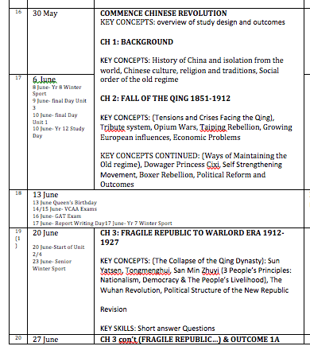
A LOOK AT THE UNIT OUTLINE…
A LOT TO DO IN THE NEXT 2 WEEKS?
Pre-study design
Chapters 1 & 2
Outcome 1A. Holiday Class??

Slide 3
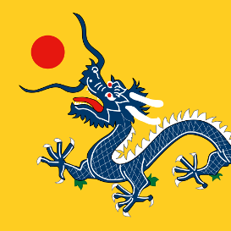
CONTENTS: (THE NEXT 2 WEEKS)
REVISION – CULTURE, RELGION & TRADITION
REVISION - EMPERORS & QING RULE
SOCIAL ORDER OF THE OLD REGIME (CLASS CONSTRUCTION)
INTERNAL THREATS IN CHINA (BRAINSTORM & REVISION)
EXTERNAL PRESSURES
TRIBUTE SYSTEM
GUANZHOU (CANTON) TRADING SYSTEM
OPIUM WARS
GROWING EUROPEAN INFLUENCES
ECONOMIC PROBLEMS
MAINTAINING ORDER & CIXI (HOMEWORK)

Slide 4
Culture, religion & tradition
Confucianism
Based on teachings of philosopher Confucius
Ethics of obedience and authority – respecting those who are elder and in higher status.
Confucian exam – made society extremely regimented
Daoism
“The way” - balance of good V evil. Don’t challenge natural order.
Buddhism
Inner spirituality
Christianity: rice christians

Slide 5
Emperors & Qing rule
Qin dynasty: 1644 – 1912
Of Manzu (Manchu) origin
10 million Manchu of a population of 550 million
From the north
Emperor sat on dragon throne; mandate of heaven
Heaven gave its consent to the rule – if unpopular heaven would show
Forbidden City: Beijing – didn’t really emerge from here
Could be influence by eunichs & concubines.
Shenshi/Mandarin as political advisors

Slide 6
Confucian social structure
19th Century China

Slide 7
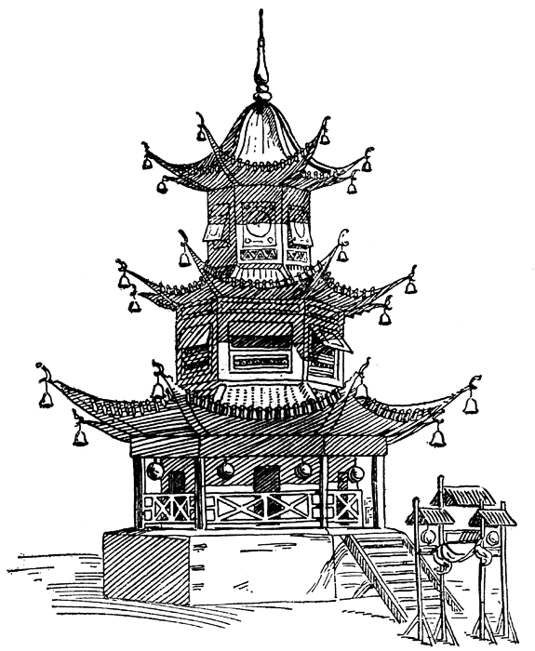
Confucian social structure
Emperor
Mandarin & Shenshi
Based on contribution to society
Peasants
Coolies (Labourers) &
Artisans (Craftsmen)
Merchants & Soldiers
Actors, Prostitutes
& Gravediggers

Slide 8
Emperor
Hereditary role
Supreme Law Maker
People bowed 3 times in his presence – commoners were not allowed to look at him at all
Surrounded by 6 major political influences

Slide 9
Mandarin & Shenshi
Successfully completed Confucian exam
Anyone could sit the exam: BUT
Had to afford the tuition
Became political advisors
“Society was structured by those who worked with their minds and governed those who worked with their hands.”
Mandarin were those of the highest level: highest percentile in exam and attained best positions as advisors to the emperor. AGAINST reform.
0.0001% of the population
Shenshi were scholar officers – generally became landowners.

Slide 10
Peasants
Vital role in the economy
Producers of food – without food nobody could live
80% of the population were peasants
15% of the land was consistently useful
Very careful of their practices (gardeners)
Population boom: 200 mil (1700s) to 480 mil (1850s)
Scarcity of land (less land available for more people)
Led to increase of prices
Reliance on land-lords who purchased land and then leased it to peasants.
Average life expectancy: 25 years old

Slide 11
Coolies (labourers) & Artisans (craftsmen)
Though most were poor, they were valued in society: made a contribution (services to society)
Producers of useful goods and services
Builders etc…
The artisans were successful if they managed a business well.
Most lived and worked in towns/cities

Slide 12
Merchants & Soldiers
Soldiers earned their living by killing and so therefore not liked
Good iron is not made into nails, good men do not become soldiers.
A lot of men were conscripted (no choice)
Merchants made living ($$) by selling the products of other people’s work

Slide 13
Actors, Prostitutes & Gravediggers
Socially outcast
Not socially acceptable practices – no contribution to society

Slide 14
Internal threats (revision)

Slide 15
Internal threats
What were the internal threats in China?
Repeated famine & poverty
Population increases
Opium
So many people addicted
Agricultural output declined
Peasants spending at least 50% of their income on Opium
Rigid social structure
Emperor
Lack of change from the forbidden city
Economic problems
Minorities ruling over China
Outdates social practices that were enforced:
Women had to bind their feet – socially outcast
Queue hair cut (shaved forehead with long tail) – symbol of subservience.

Slide 16
external threats

Slide 17
external threats
TRIBUTE SYSTEM & GUANGZHOU (CANTON)
China = isolationist
China is self sufficient.
Series of gifts given to Celestial Kingdom and the emperor as symbol of being inferior to China.
1793 = Lord Macartney
Anti ‘foreigners’
China’s neighbors are inferior – led Chinese to be arrogant in some aspects
Foreigners were forbidden to learn Chinese

Slide 18
external threats
TRIBUTE SYSTEM & GUANGZHOU (CANTON)
China = isolationist
China is self sufficient.
Series of gifts given to Celestial Kingdom and the emperor as symbol of being inferior to China.
1793 = Lord Macartney
Anti ‘foreigners’
China’s neighbors are inferior – led Chinese to be arrogant in some aspects
Foreigners were forbidden to learn Chinese

Slide 19
external threats
OPIUM TRADE
All trade under the ‘Canton System of Trade’
Restricted, heavily weighted in China’s favour
Lopsided balance of trade: Chinese commodities out, British silver bullion in.
British merchants could not trade 1-1, instead had to trader through a member of the Cohong
Britain losing money through the Guangzhou trading system.
Only commodity which Britain imported into China that could be sold = Opium (illegally)
1729 (200 chests); 1767 (1000); 1820 (4,500);
1830 (10,000); 1839 (40,000) – imports are now supplying 2.1 million people
By 1830s drug smuggling dominates all other commodities

Slide 20
external threats
OPIUM TRADE
1834: British East India Company Dissolves – now minor shipping merchants can trade
1838: Lin Zexu is appointed by emperor Daoguang to stop opium trade
1839: publicly seizes and burns 21,000 chests of Opium
Snowballed into first Opium War 1840
1842: Treaty of Nanjing
Ceded Hong Kong to Britain
New treaty ports open (Amoy, Ningbo & Shanghai)
Pay compensation for lost Opium
Ensured the Cohong was abolished (China loses more $)
1843: Extraterritoriality (foreigners now exempt from Chinese law)

Slide 21
external threats
1856: Second Opium War
Treaty of Tianjin (Tietsin)
Six more treaty ports opened
Customs set up under foreign control
Opium allowed
Christian missionaries could be established
European ambassadors allowed in Beijing
Loss of territory (Russia – north of Armur river, France – Guangzhou, Germany – Shandong)
China now had to:
Now recognize foreigners and Western ‘control’
European influences now very visible
No control over customs & imports (inc Opium)
Huge loss of money (Canton system abolished and other ports open for ‘free-for-all’
China now very much inferior!
Chinese feel oppressed: RESENTMENT TOWARDS FOREIGNERS

Slide 22
Internal threat – Taiping rebellion
1851 – 1864
Emerged as Opium Wars had shown China to be internally vulnerable
Gained popularity as most resented Manzu (Qing) rule.
Hatred of hierarchy and emperor
Forced social expectations (such as haircut and foot binding)
Stated that men and women were equal
LAND REFORM: promised land to peasants
Imperial rule eventually won, but
Only through assistance of the EVA (Ever Victorious army) run by western (foreign) armies
Further creates resentment towards the Qing
HOMEWORK: Read pages 15-20
Answer all questions on page 18 and on page 19

