Slide 1
Revolution Exam
Sections & Format

Slide 2
The exam
SECTION A:
PART 1: SHORT ANSWER QUESTIONS x2 (AOS 1)
PART 2: DOCUMENT ANALYSIS (AOS 2)
SECTION B:
PART 1: DOCUMENT ANALYSIS (AOS 1)
PART 2: ESSAY (AOS 2)
** EACH SECTION MUST DEAL WITH A DIFFERENT REVOLUTION !
15 MINUTES READING TIME; 2 HOURS WRITING (ALLOCATE 30 MINS PER ANSWER)

Slide 3
WHAT TO DO NOW?
REVISE CONTENT: YOU SHOULD ALREADY BE DOING THIS! (MILE)
REVISE THE 3 DIFFERENT STRUCTURES; HOW DO I CONSTRUCT ANSWERS
HISTORIANS QUOTES: SHORT & EASY TO REMEMBER

Slide 4
SHORT ANSWER QUESTIONS
Using three to four points, explain … contributed to the development of the Revolution.
Provide evidence to support your answer
10 Marks allocated per response
20 lines

Slide 5
… explain how defeat in the Russo Japanese War of 1904 contributed to a revolutionary situation in 1905
The unexpected defeat of Russia in the Russo–Japanese War was highly significant in contributing to a revolutionary situation by 1905. Firstly, soldiers who were angered by the harsh conditions they had endured during the war and their humiliating defeat, began to revolt in certain instances like the mutiny of the Battleship Potemkin in 1905. This allowed the Tsar to understand the seriousness of the possible threat to his power. What is more, this same dissatisfaction with the defeat and disillusionment with the Tsar was re-echoed amongst urban population as people were shocked that Tsarist Russia had succumbed so easily to an Asian nation which had been held in contempt as inherently inferior. The fact that nearly half the Russian fleet had been sunk in the Battle of Tsushima Straits (May 1905) shocked the Russian people and led them to question the supposed infallibility and omnipotence of their aristocratic leader, Nicholas II. Furthermore, the cost of engagement in the war had compounded the already serious economic problems, causing a decline in living standards and consequently simmering dissatisfaction that threatened to over boil. E.g. In Russian cities there were an average 16 people to an apartment and factory workers endured 60 hour working weeks. Thus the ‘spark’ of the January Bloody Sunday massacre caused the flames of revolution to arise. Finally the fact that angry sailors and soldiers were returning to St. Petersburg in October 1905 as a massive general strike was raging, forced the Tsar to take action because he knew they could otherwise add to the growing unrest and lead to a full blown revolution. Thus the Tsar introduced the October Manifesto which promised reform in October 17 1905.

Slide 6
SHORT ANSWER QUESTIONS
Topic Sentence
Signpost
Explain how - “significance”
Evidence to support your answer
Dates, Facts & Figures
Historians?

Slide 7
Section A- Part 2 and Section B- Part 1 Document Analysis
These two parts of the exam form one half of your exam marks.
Section A Part 2 assesses Area of Study 1 of your first chosen revolution while Section B Part 1 assesses Area of Study 2 of your second chosen revolution.
You are given four questions (labeled a to d) on each document.
The document could be any of the following types of documents:

Slide 8
Primary source document

Slide 9
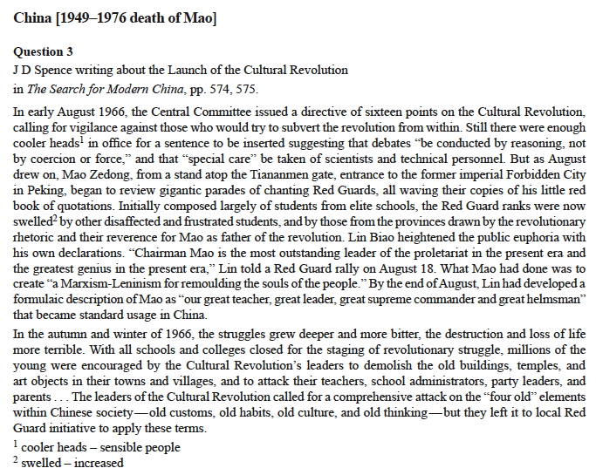
Historian’s account

Slide 10
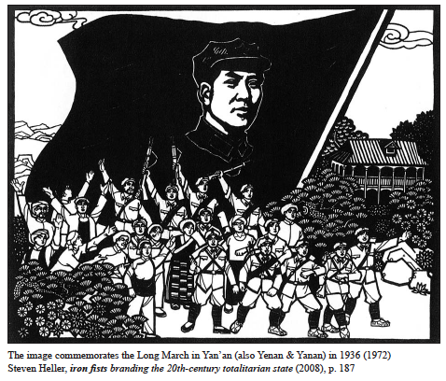
Image

Slide 11
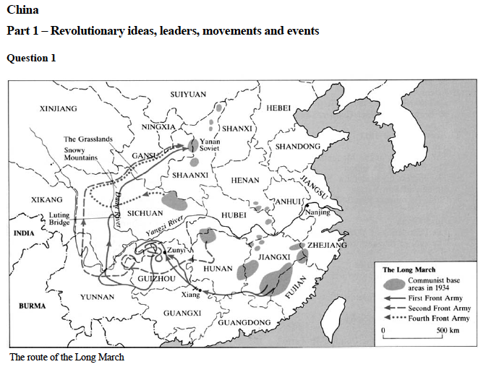
Map?

Slide 12
Questions A and B
If you are asked to LIST/NAME do JUST THAT – be sure to know what the question is asking though – ie; details/features that represent…/social groups etc
Quotes from documents are okay as long as they answer the question
Nothing wrong with very short answers as long as they ANSWER THE QUESTION!

Slide 13
Question C
MUST quote, paraphrase or refer to the extract
As the representation suggests…
As portrayed in the representation by…
This is shown in the extract…
As stated by Lenin in the extract…
MUST also introduce information NOT in the source
EXPLAIN why – need to put in context
MUST contain 3 main points

Slide 14
Question D
Read the question CAREFULLY to determine what aspect of the document/graphic you’re discussing
Need to EVALUATE and say why it’s useful/reliable/accurate
What can you see that is reliable or unreliable
What is MISSING or IGNORED?
Try to point out 3-4 elements of the document that are reliable/unreliable- include at least one of each
You MUST compare parts of the piece with other perspectives- ie historians or eye witnesses. Different views can either support or go against the view put forward in the document
Need to MEASURE the viewpoint against that of others

Slide 15
ESSAY
Will give you a quote and then an essay question:
In 1949 Mao claimed in ‘On the People’s Democratic Dictatorship’ that the CCP was leading an alliance of classes, all of which were to enjoy democratic rights and freedoms.
Discuss the extent to which the new society achieved its aims of securing the rights and freedoms of the people.
Use evidence to support your response.

Slide 16
ESSAY
Must be structured
Introduction: what topics will you address
Signposting
Body: at least 3 body paragraphs
Disclaimer/Rebuttal Paragraph
Conclusion: summary of your ideas and how you arrived at your contention

Slide 17
ESSAY
Introduction
Contention: what will you argue?
Use the prompt and the essay question to help arrive to a well rounded contention
Signposted arguments
Conclude your introduction

Slide 18
ESSAY
Body
Topic Sentences are a MUST
Explain
Evidence
Link/Conclude (back to essay question)

Slide 19
ESSAY
Body (Evidence)
The best essays referred closely to the terms in the question and used a range of evidence to support their interpretation. Too often, historians’ views were used in place of evidence rather than as an opinion to support the evidence. Students should supply their own factual evidence and confirm it with an historian’s viewpoint rather than only use the viewpoint. The highest scoring essays used specific factual evidence such as statistics, quotes, dates, names, policies or events to support all their points. Weaker responses tended to narrate, describing anything about the revolution, often without clear relevance.

Slide 20
ESSAY
Body – Rebuttal Paragraph
Can be used as a final paragraph to include more information but to also knock down any arguments from another side
Very argumentative!
For example
The Hundred Flowers Campaign from 1957 did allow freedoms under the new regime, but these were very short lived. The population were now encouraged to voice their grievances and speak out about their living conditions. Mao had hoped by introducing this policy that he could avoid the same problems that had been happening in Hungary with the desalinization process that had been happening after the death of Stalin in March 1953. Historian Jack Gray stated that Mao hoped that “China would be inoculated with a benign form of the Hungarian distemper, and so saved from the real disease.” However this was short lived and the promises of freedoms of speech were quickly withdrawn …

Slide 21
ESSAY
Conclusion
So often we run out of time to include a conclusion.
Important to sum up your ideas.
Sentence which summarises a paragraph and uses a piece of evidence to support that claim.
Last sentence should sum up all your ideas and link to the essay question.

