Slide 1
Self strengthening and Cixi Self strengthening and Cixi Self strengthening and Cixi Self strengthening and Cixi Self strengthening and Cixi Self strengthening and Cixi Self strengthening and Cixi Self strengthening and Cixi Self strengthening and Cixi Self strengthening and Cixi Self strengthening and Cixi Self strengthening and Cixi Self strengthening and Cixi Self strengthening and Cixi Self strengthening

Slide 2
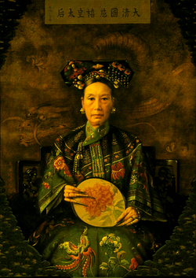
Cixi
“Her ruthlessness was as proverbial as her extravagance.” – John Robottom
Cixi was the concubine of Emperor Xianfeng.
As his wife Cian was not able to have
children, Cixi gave him his only heir;
Tonghzi.
After Xianfeng’s death in 1861, the
Gang of Eight headed by Prince Su
Shun, assumed powers of regency.
However, Prince Gong and Empresses
Cixi and Cian staged a successful coup
and became co-regents.
1835-1908

Slide 3
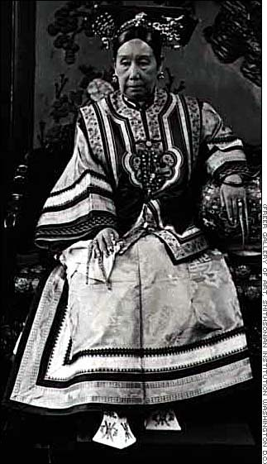
As co-regents, Empress Cixi and Empress Cian were required to take part in the Imperial Court. However, women were not permitted to be present during an Imperial assembly and instead they managed affairs behind a silk curtain.
As Cian was relatively reserved, Cixi became the dominant force and was known as the ‘power behind the silk curtain.’
Empress Cixi lived an extravagant lifestyle surrounded by ‘half-men’ slaves who were rumoured to have not been eunuch but rather her sex slaves.

Slide 4
When Emperor Tonghzi died in 1875 aged 19, Cixi used her influence in order to all her nephew Guangxu to precede him.
As he was also a child emperor, Cixi adopted him as her son in order to remain regent. She did not allow Guangxu full reign until 1189 when he was married.
Common portrayals:
Wicked Witch of the West/Empress of the West
A reptilian dragon lady
Iron-willed, oversexed Manchu concubine

Slide 5
Self
strengthening
Self strengthening was the approach taken by Prince Gong from 1861 until 1895 in order to modernise China.
After becoming co-regent, Prince Gong took initiatives in improving China’s diplomatic relations and military. He established the Zongli Yamen (Ministry for Foreign Affairs) and in 1862 founded a school to teach Chinese scholars foreign languages, Western science and mathematics.
Leading theorist in self-strengthening, Feng Guifen believe that in order to strenthen the Qing state, China needed to preserve traditional Confucian culture and institutions but supplement them with Western weapons and technology.

Slide 6
“At first they may take the foreigners as their teachers and models, then they may come to the same level and be their equals; finally they may move ahead and surpass them. Herein lies the way to self-strengthening.” – Feng Guifen
The policies of Self strengthening resulted in:
Modern dockyard at Fuzhou
Machine factory at Tianjin
Arsenals at Nanjing
Founding of a Chinese merchant shipping line
Beginnings of a modern navy

Slide 7
The negatives of Self strengthening for China was:
There was a preoccupation with Western ships and weapons rather than internal problems and culture
‘Underpinnings’ of the Western approach were ignored resulting in lack of quality in its outputs;
Military training and operations
Weapons and ships
Weapons and ships sold to China by Britain were similarly sub-standard, leading to several Chinese defeats:
Losing of control of Indo-China (Vietnam) to France in 1884-85
Giving away of Taiwan to Japan in 1894-95)

